Slide 1
Prelude
to
Civil War
Notes:
<number>

Slide 2
1788-1860 North developed and Changed by Industrial Revolution
Rapid population growth, European immigrants
Diversified economy - only 4% small farmers
Capitalism
Strong industrial & merchant sector develops

Slide 3
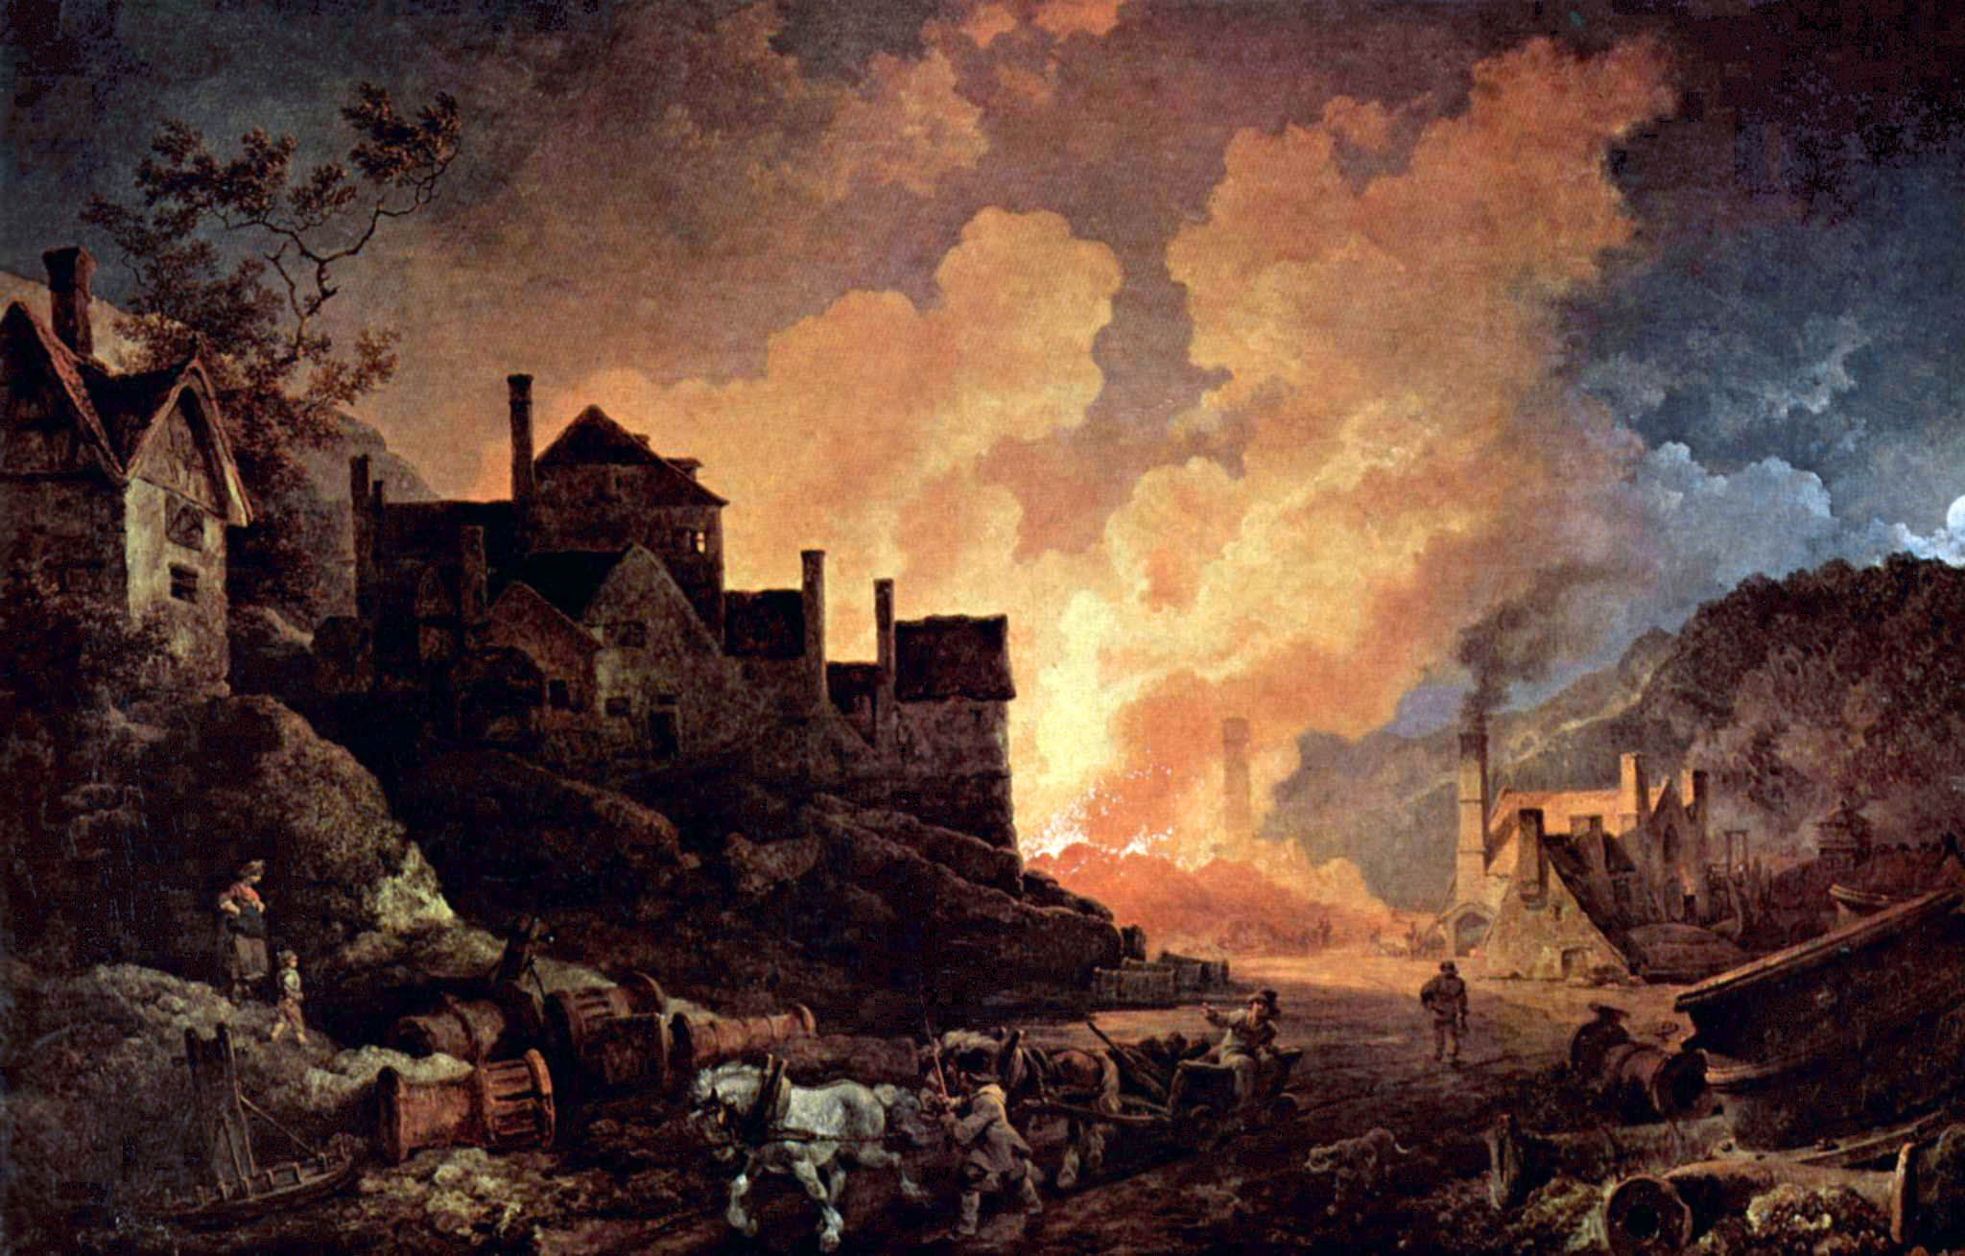

Slide 4
1788-1860 North
Protestantism dominant religion influencing political and economic leadership
Reform movement thrives in North, due to effects of Industrial Revolution and city growth (Temperance, Poor Housing, Child Labor, Public Education, Abolitionism)
Negative perception of Southerners

Slide 5
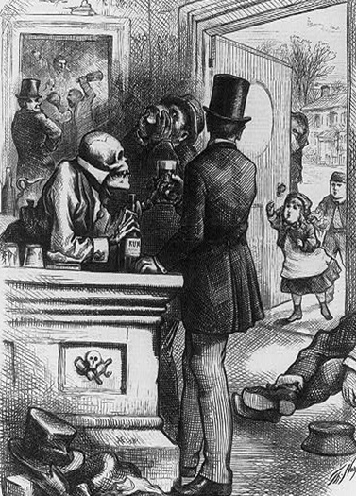
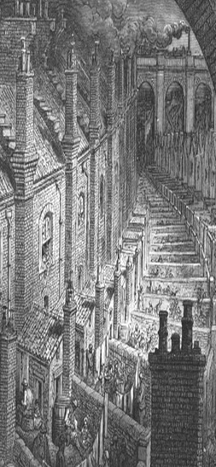

Slide 6
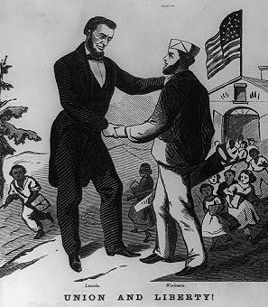
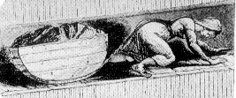
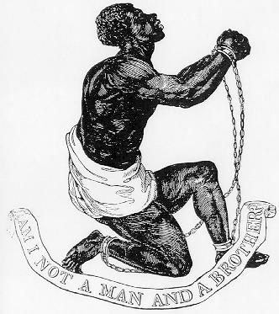

Slide 7
1788-1860 South Traditional & Agricultural
Population growth slower - less immigration
-South not as urban
-Lower population= Less House Representatives
Religion protestant, more personal than in north
-More interest in personal salvation than society
Public education & reform not important
Cash crops grown, "King Cotton" major crop

Slide 8
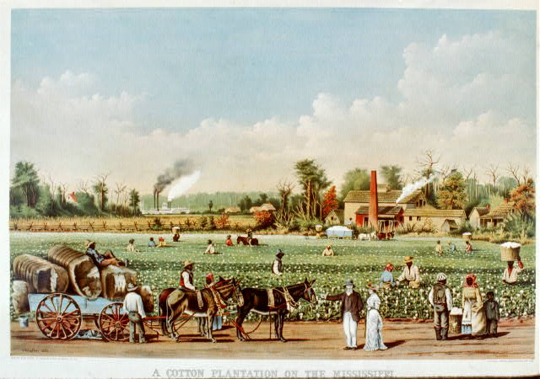

Slide 9
1788-1860 South
80% economy focused on agriculture
Slavery major influence
Political leaders large land owners/slaveholders
25% people own slaves, 12% own 12 or more
All Southerners had stake in slavery’s institution
Negative perceptions of Northerners

Slide 10
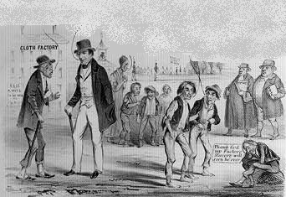
Southern View-“Northern Slavery”
"Why Friend, how is it that you look so old? "
"I’m a "fast man“, we usually die of old age at 40.”
"I’m going to run away to the Coal Mines only work 14 hours a Day."
"Oh! how I would like to have such a comfortable place. . . “
"Oh Dear! what wretched Slaves, this Factory Life makes me & my children.“
"Thank God my Factory Slavery will soon be over."

Slide 11
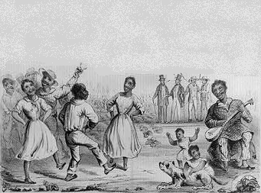
Southern View on Southern Slavery
"Is it possible that we of the North have been so deceived by false Reports? Why did we not visit the South before we caused this trouble between the North and South.”
"It is as a general thing, some few exceptions, after mine have done a certain amount of Labor which they finish by 4 or 5 P.M. I allow them to enjoy themselves in any reasonable way."

Slide 12
Territorial Expansion Poisoned National Politics
New States- More Congressmen & Senators
More politicians changes control of Congress
North- Concerned over expansion of slavery & dealing with Industrial Revolution’s effects
South- Concerned with protecting their social system and economic system

Slide 13
Political, social, and economic environments deteriorate into an issue of new states being “Southern Slave” or “Northern Free States”

Slide 14
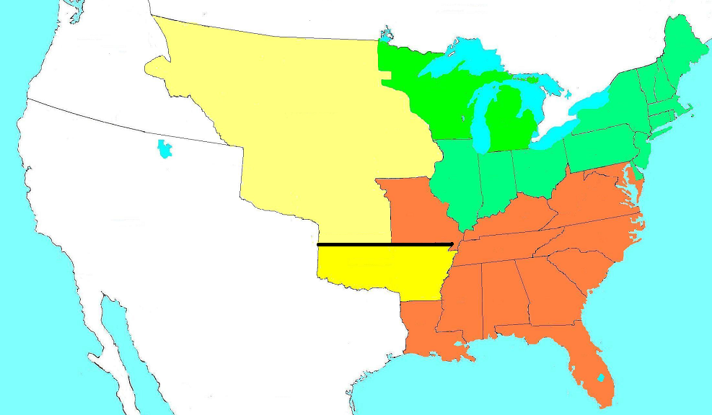
Missouri Compromise of 1820
ME
Unorganized Territory
Closed to Slavery
Michigan Territory
No Slavery
No Slavery
MO
36* 30’ Missouri
Compromise Line
Slave States
Arkansas Territory
Open to Slavery
Missouri enters US as a slave state
Maine enters US as a free state
No slavery north of 36* 31” latitude

Slide 15
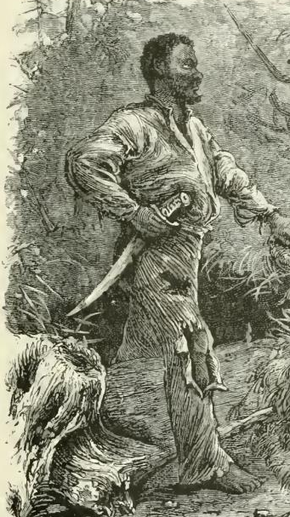
1831 Critical year
Nat Turner leads violent slave revolt killing 55 men, women, & children
Abolitionist newspaper The Liberator began.
South Carolina nullifies (fails to obey) Federal Tariff Law

Slide 16
US gains new territory. Will the North or South control new states? Will Slavery be allowed or not?
Country of Texas joins the US 1845
Oregon territory 1846
Land gained in Mexican War 1848
Wilmot Proviso- US buys land

Slide 17
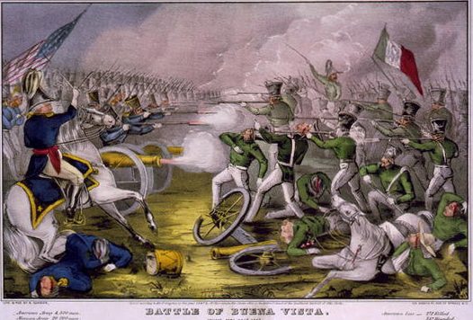
Mexican War 1847-48
Library of Congress

Slide 18
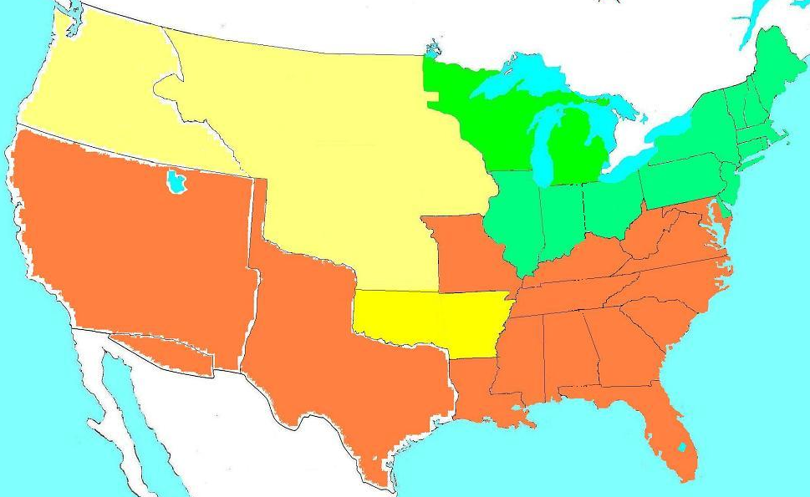
New US Territories
Oregon
Territory
From Britain
1846
Acquired though Mexican War 1848
Texas
Annexation
1845
Gadsden Purchase 1853

Slide 19
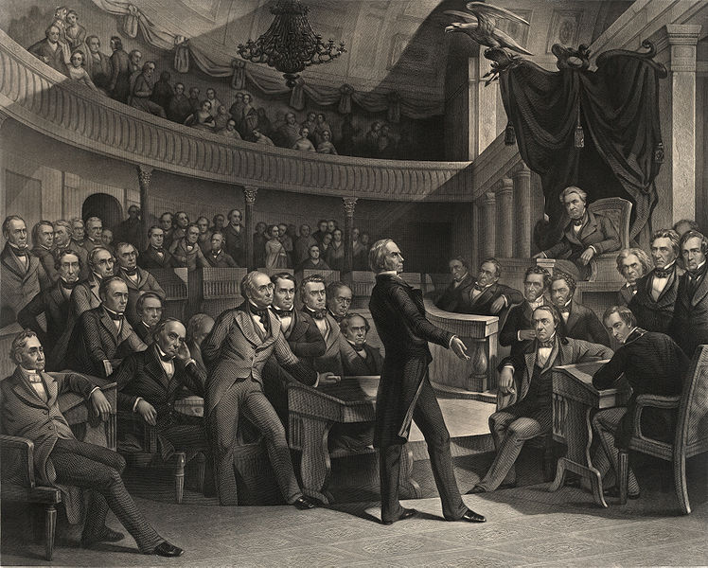
Compromise of 1850 Calms Things
Satisfies neither North or South
California becomes free state, North has more
Tough Fugitive (Runaway) Slave laws for South
Henry Clay Takes Senate Floor

Slide 20
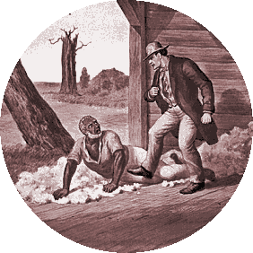
1852 Novel: Uncle Tom’s Cabin creates furor nationwide
Simon Legree assaulting Uncle Tom.

Slide 21
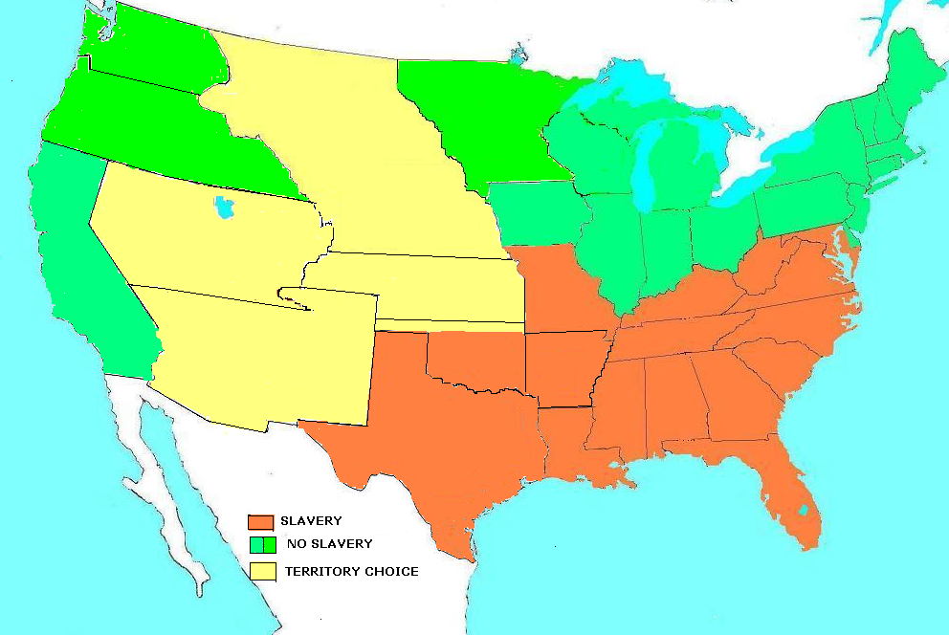
US by 1854
Washington Territory
US 1854
Minnesota
Territory
Oregon Territory
Nebraska
Territory
Utah
Territory
Kansas Territory
New Mexico
Territory
Indian Territory

Slide 22
Kansas-Nebraska Act of 1854
Creates concept of “Popular Sovereignty” allowing states to decide on issue of slavery
Effectively repealing Missouri Compromise
Bleeding Kansas- Violence erupts in Kansas between pro-slave and anti-slavery supporters

Slide 23
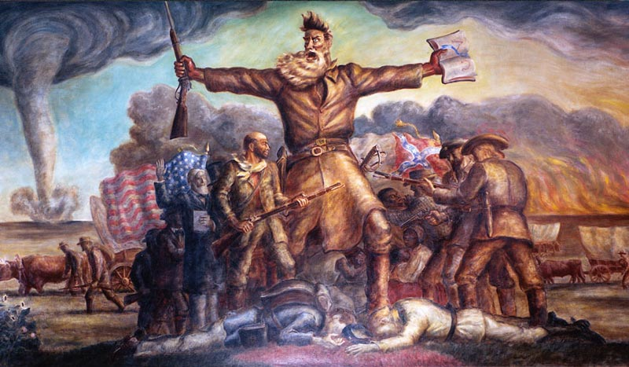
Kansas State Historical Society, Copy and Reuse Restrictions Apply www.kshs.org/reasearch/collections/documents/photos/webuse.htm

Slide 24
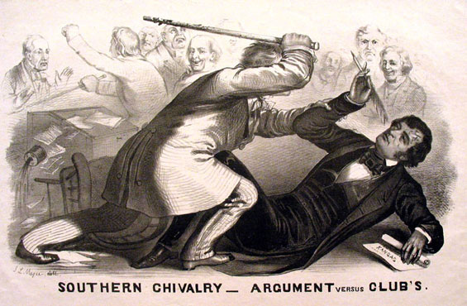
1856 SC Senator Booker beats MA Senator Sumner with a cane.
U

Slide 25
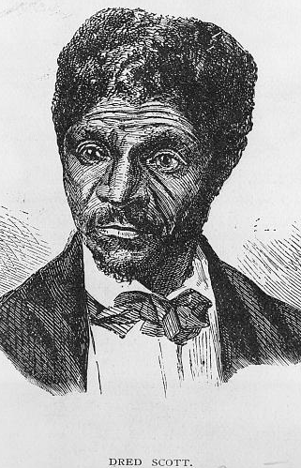
Dred Scot Decision of 1857
Supreme Court Rules:
Slaves not citizens, they are property
Missouri Compromise violated 5th Amendment
Congress must protect slaves as property.
Library of Congress

Slide 26
National Institutions Divide
Churches divided into branches North/South
National Parties split - North/South
Whig Party dies in 1852
Democratic Party essentially a Southern party
1856 Republican Party founded essentially a Northern party

Slide 27
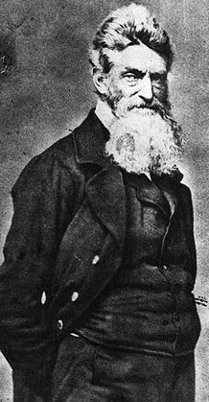
John Brown Takes Harpers Ferry, October 16, 1859
John Brown & 21 armed followers take US arsenal & rifle works in Harpers Ferry, VA
They hope to spark a rebellion of freed slaves and to lead an army of emancipation .

Slide 28
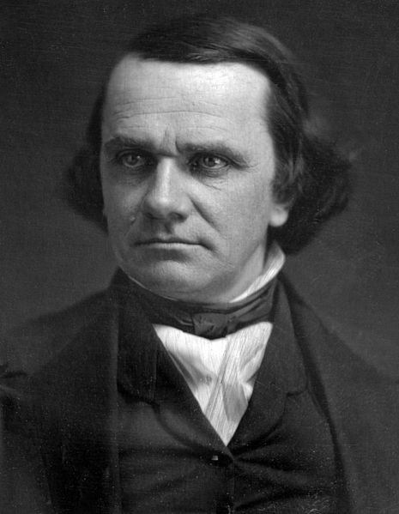
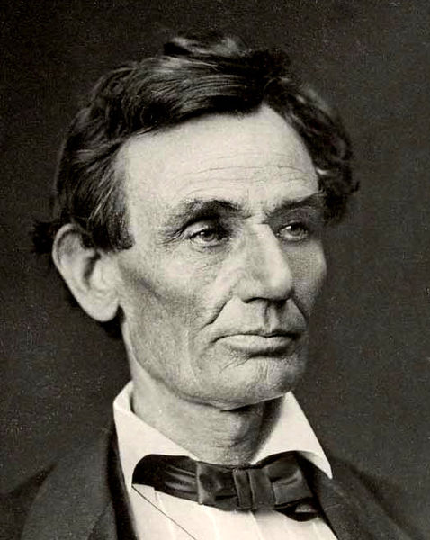
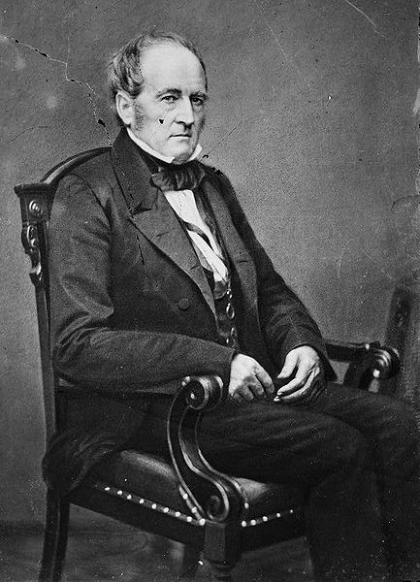
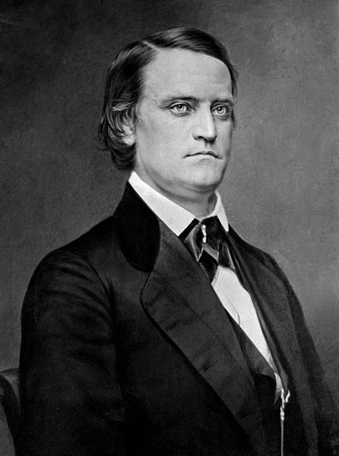
Election of 1860
Stephen Douglas
Northern Democrats
Abraham Lincoln
Republican Party
In North Only
John Breckenridge
Southern Democrats
John Bell
South Constitutional Union Party

Slide 29
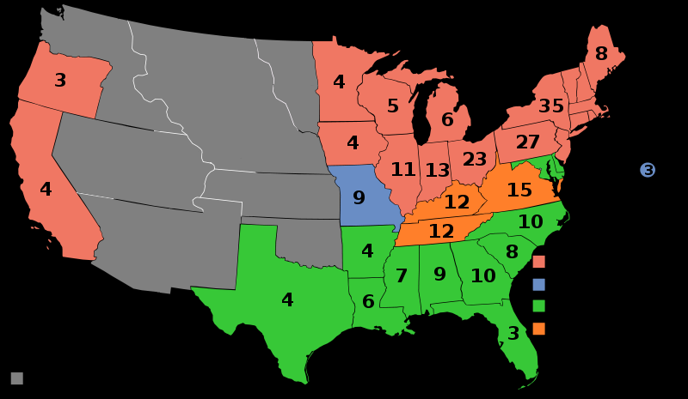
1860 Electoral College Map
VT5,
NH5
MA 13
RI4
CT 6
NJ 4
DE 3
MD 8
Lincoln
Douglas
Breckenridge
Bell

Slide 30
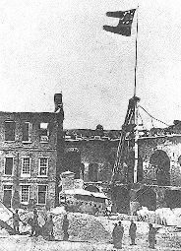
December 20, 1860 South Carolina becomes the first state to secede from the US

Slide 31
Sponsored by the Sons of Union Veterans of the Civil War http://www.suvcw.org

