Slide 1
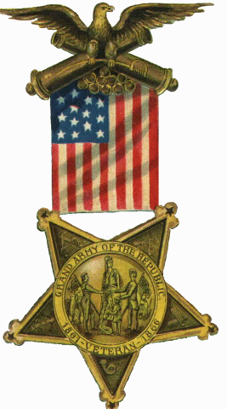
Brief History Of The Grand Army Of The Republic

Slide 2
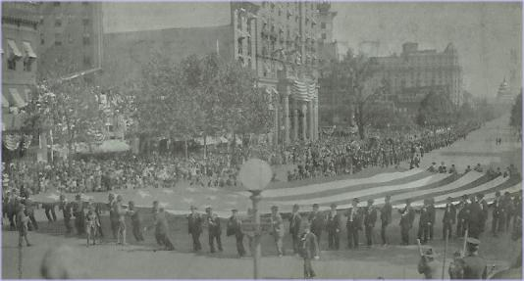
In early 1866 the United States--now securely one nation again--was waking to the reality of recovery from a much different war.
GAR McKinley Post #25 of Canton Washington, DC Parade 1915
In previous conflicts the veterans care was the job of family or community. Soldiers then were friends, relatives and neighbors who went off to fight--until the next planting or harvest. It was a community adventure and their fighting unit had a community flavor.

Slide 3
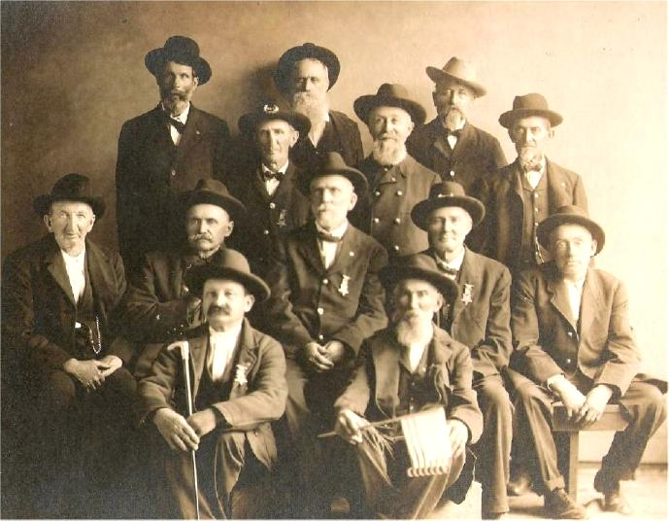
Monroe County, Illinois GAR Veterans
In the Civil War, units had become less homogeneous, men from different communities and states were forced together and new friendships and lasting trust was forged. With advances in medical care, many who would have died in earlier wars returned home to be cared for by the community. The needs of widows and orphans needed faced. Veterans needed jobs. It was often more than communities could bear.

Slide 4
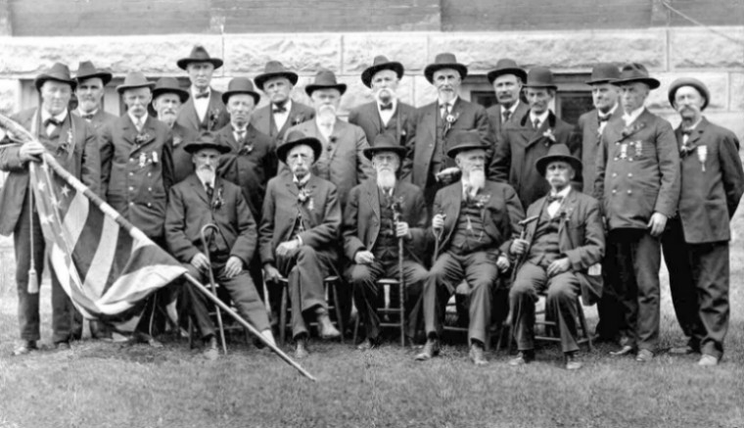
GAR Post 522, Yorkville, Illinois on Memorial Day, 1911.
State & federal leaders had promised to care for "those who have borne the burden, his widows and orphans“, but had little knowledge of how to accomplish the task. There was little political pressure keep these promises

Slide 5
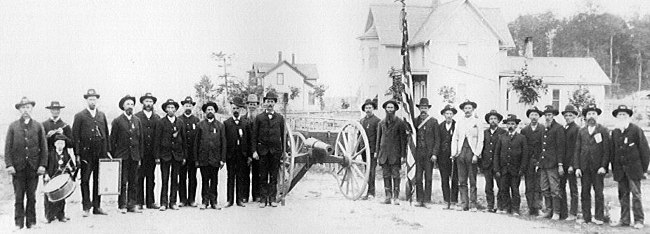
George W. Bell Post #53 Wonewoc, Wisconsin
Probably the most profound emotion was emptiness. Men who had lived, fought, foraged and survived together, had developed an unique unbreakable bond. Time removed memories of the filthy, vile environment of camp life, which became remembered less harshly & eventually fondly. The horror & gore of battle lifted and was replaced with the personal rain of tears for the departed comrades. Friendships forged in battle survived the separation and the warriors missed the warmth of trusting companionship that had asked only total and absolute commitment.

Slide 6
Groups of veterans began joining together--first for camaraderie and then for political power. Emerging most powerful among the various organizations would be the Grand Army of the Republic (GAR),
which by 1890 would number 409,489.

Slide 7
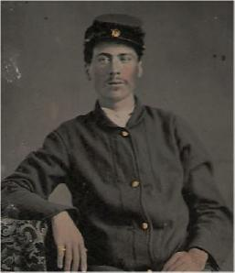
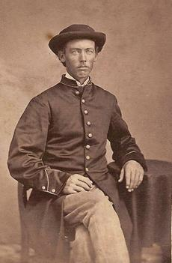
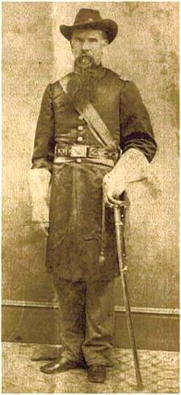
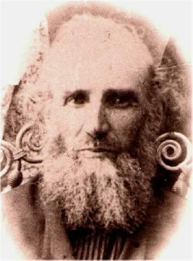
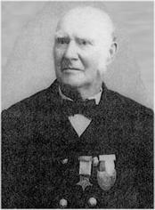
Founded in Decatur, Ill. on April 6, 1866 by
Benjamin F. Stephenson, membership limited
to honorably discharged veterans of the Union Army, Navy, Marine Corps or Revenue Cutter Service serving between April 12, 1861 & April 9, 1865.
William Henry Park Jr.
Daniel Mote
Samuel Ake Shattuck James Sowry

Slide 8
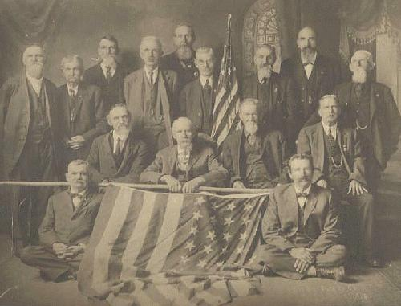
Heald GAR Post #253, Dushville (Winn), Michigan
The official body of the Department was the annual Encampment, which was presided over by the elected Department Commander, Senior and Junior Vice Commanders and the Council. Encampments were elaborate multi-day events, which often included camping out, formal dinners, and memorial events.

Slide 9
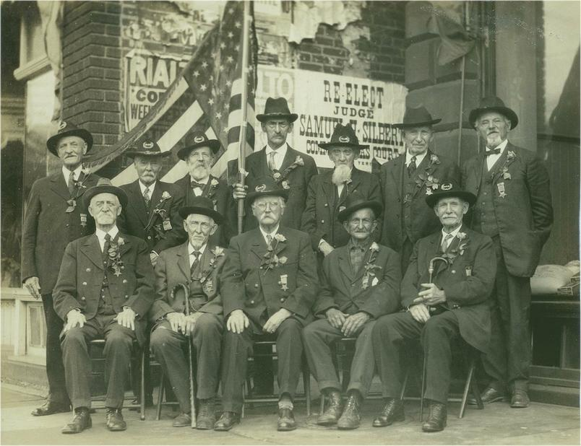
1930s Photograph GAR Past CinC Oley Nelson (1935/36), Samuel P. Town (1931/32), Russell C. Martin (1932/33), James E. Jewel (1930/31), John Reese (1928/29).
National Encampments of the Grand Army of the Republic were presided over
by a Commander-in-Chief who was elected in political events, which rivaled national political party conventions. The Senior and Junior Vice Commander
in-Chief as well as the National Council of Administration were also elected.

Slide 10
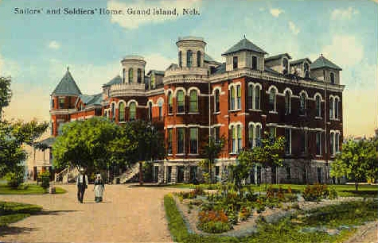
The GAR founded soldiers' homes, was active in relief work and pension legislation. Five members were elected US President: Grant, Hayes, Garfield, Harrison, and McKinley. For a time, it was impossible to be nominated on the Republican ticket without GAR endorsement.

Slide 11
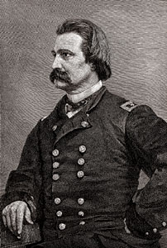
In 1868, Commander-in-Chief John A. Logan issued General Order No. 11 calling for all Departments and Posts to set aside the 30th of May a day for remembering the sacrifices.

Slide 12
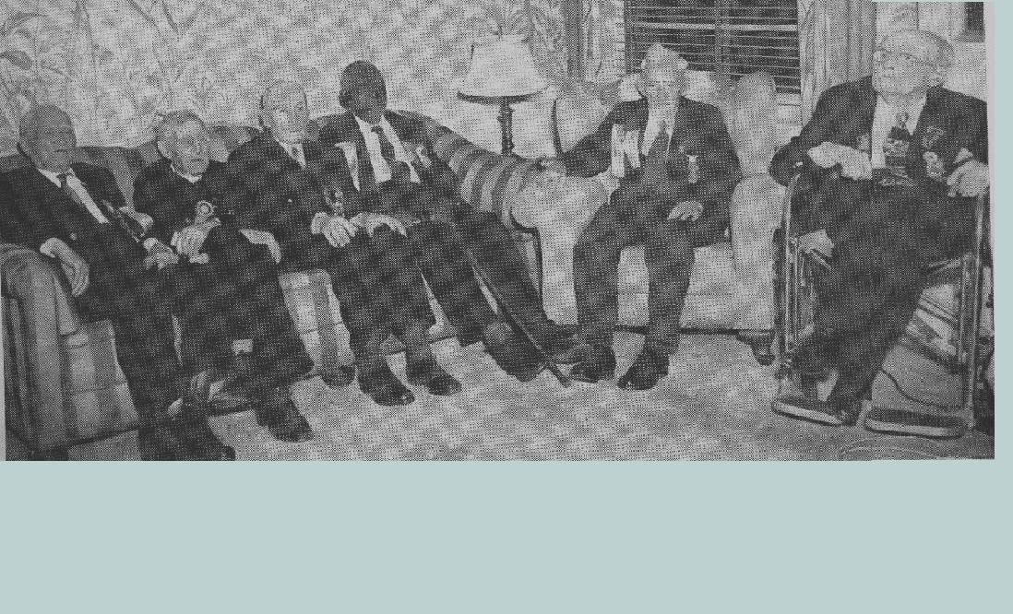
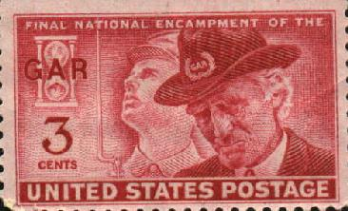
The final Encampment of the Grand Army of the Republic was held in Indianapolis, Indiana in 1949.
The last member, Albert Woolson died in 1956
at the age of 109 years.

Slide 13
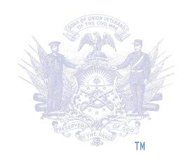
Sponsored by the Sons of
Union Veterans of the Civil War
http://www.suvcw.org

