Slide 2
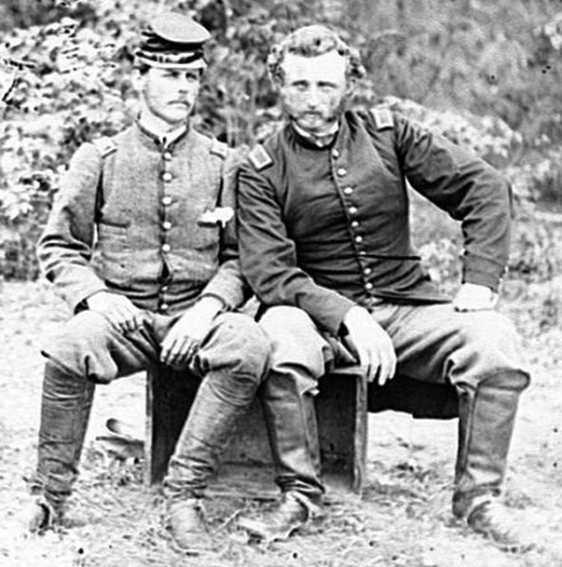
Nearly four million men served during the Civil War
Classmates:
Confederate Lt. James B. Washington and Union Capt. George A. Custer

Slide 3
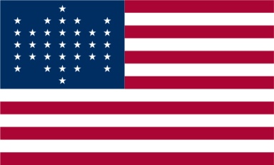
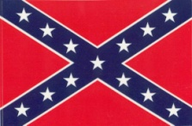
North
Union
Billy Yank
Yankee
Federal
USA
South
Confederate
Johnny Reb
Rebel
CSA
CSA Battle Flag

Slide 4
Names For The Civil War
War of the Rebellion
The War Between the States The War for States' Rights Mr. Lincoln's War The War for Southern Rights The Second War for Independence The War to Suppress Yankee Arrogance The Brothers' War The War Against Slavery The War Against Northern Aggression The Yankee Invasion The War for Southern Freedom

Slide 5
Why Two Names For Battles? Northern troops named after nature. Southerners after man made things.
Date Southern Name Northern Name
July 21, 1861 First Manassas Bull Run
Apr. 6-7, 1862 Shiloh Pittsburg Landing
June 27, 1862 Gaines's Mill Chickahominy
Aug. 29-30,1862 Second Manassas Second Bull Run
Sept. 14, 1862 Boonsboro South Mountain
Sept. 17, 1862 Sharpsburg Antietam
Jan 2, 1863 Murfreesboro Stones River
Apr. 8, 1864 Mansfield Sabine Cross Roads

Slide 6
Civil War "Firsts"
Weapons
Workable machine gun Successful submarine Aerial reconnaissance Antiaircraft fire Flame throwers Land-mine fields Naval torpedoes Railroad artillery Repeating rifles Revolving gun turrets Wire entanglements
Political
American Draft American bread lines
President Killed Blackouts
Aerial camouflage Cigarette tax
Income tax
Tobacco tax U.S. Secret Service
Withholding tax

Slide 7
What Caused the Civil War?
Political Power Struggles
State verses Federal Rights
Economic Issues
Cultural Differences
Lincoln’s Election
Woven throughout is the issue of slavery.

Slide 8
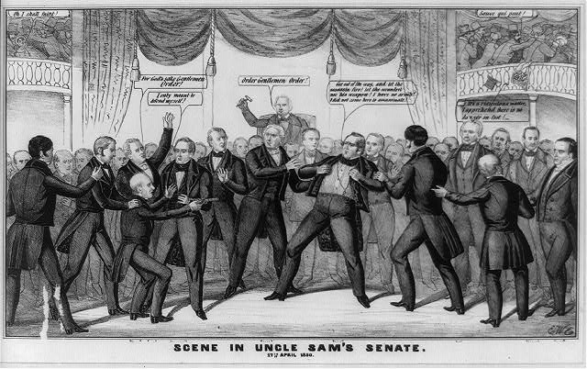
Politics

Slide 9
Northern and mid-western states become
more powerful as their populations increased.
Southern states lost political power because their population did not increase as rapidly.
Southerners charged their voices were not heard in congress.

Slide 10
New Territories & States
Northerners want new states “slave free”
Slave owners felt their right to settle the West with their "property," including slaves, was being infringed.
If slavery was not allowed in west, the South would loose more political control.

Slide 11
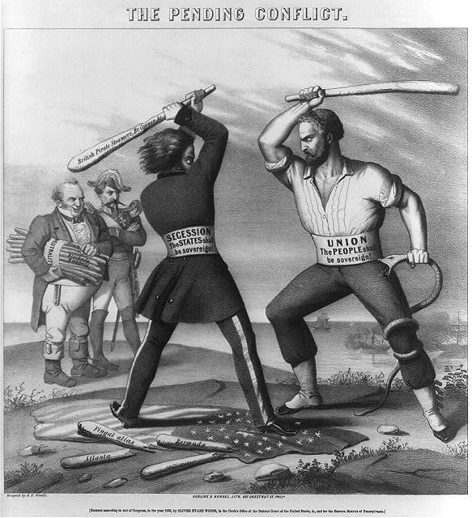
States Rights
South believed State laws carried more weight than Federal laws & should be obeyed first.
This included the right to Secede or leave the Nation
North disagreed.

Slide 12
Economic
Tariffs- government tax on imported goods
Southern Congressmen generally opposed them, Northerners generally supported them.
Tariffs protected northern industry from foreign competition. Business interests & others influenced politicians to support high tariffs.
Southerners feared tariffs would raise European prices on goods bought by the South.

Slide 13
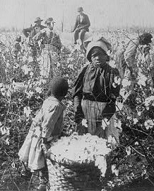
Slavery
Protected by Federal law.
Slavery part of Southern
life for over 200 years
Constitution guaranteed
right to own property.
Slaves viewed as property.
Slave labor essential to the cotton industry, but many prominent Southerners felt slavery would eventually die out, even if the South won.

Slide 14
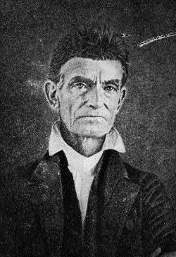
Abolitionists
Northerners who felt
slavery was uncivilized,
should be abolished and
was wrong, period,
loudly disagreed with
the South's laws and
beliefs concerning slavery.
John Brown

Slide 15
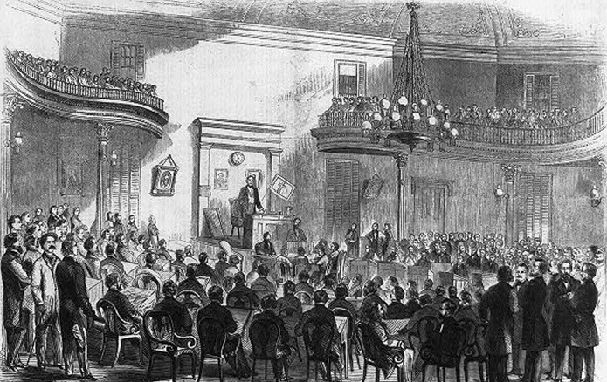
Confederate Senate Chamber 1861

Slide 16
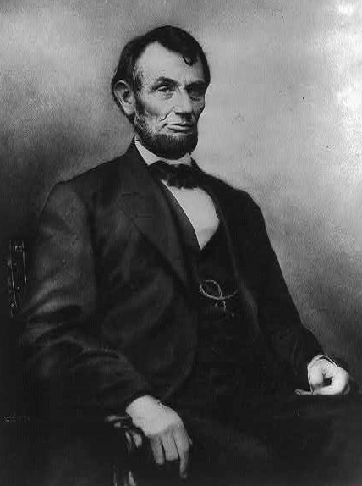
Abraham Lincoln August 22, 1862 Letter to Horace Greeley “If I could save the Union without freeing any slave I would do it, if I could save it by freeing all the slaves I would do it, and if I could save it by freeing some and leaving others alone I would also do that…”

Slide 17
1860 Election
Republican Party was viewed as friendly to abolitionists and northern businessmen.
Republican Abraham Lincoln elected President
He vowed to keep the country united & new territories free from slavery.
Southerners afraid Lincoln would not treat them fairly.
He had not appeared on the Southern Ballot

Slide 18
Confederate States of America
Created following Lincoln’s election, four states joined after his call for troops.
South Carolina Virginia
Alabama Arkansas
Mississippi Tennessee
Florida North Carolina
Georgia
Louisiana
Texas

Slide 19
Border States In The Civil War
Key for their geographic location & support
Delaware rejected a Confederate invitation.
Kentucky refused call for troops & declared neutrality, but Citizens served on both sides.
Missouri attempted neutrality, 1861 Federal invasion pushed many to the Confederates.
Maryland placed under Federal control & members of state legislature arrested preventing a state vote on secession.

Slide 20
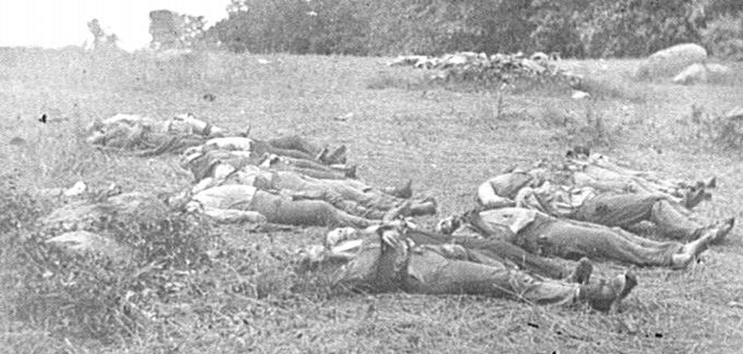

Slide 21
Bibliography
http://www.civilwarhome.com/potpourr.htm
-"Battles and Leaders of the Civil War.”
Excerpt from an article written by General D.H. Hill.
-"The Civil War, Strange & Fascinating Facts" by Burke Davis
-"Teaching American History in Maryland - Documents for the
Classroom: Arrest of the Maryland Legislature, 1861” Maryland
State Archives. 2005. http://teachingamericanhistorymd.net
http://www.historycentral.com/CivilWar/AMERICA/Economics.html
http://www.loc.gov/pictures Library of Congress Online Catalog
http://www.nps.gov/archive/gett/gettkidz/cause.htm
Gettysburg National Military Park Kidzpage

